Slide 1


Slide 2

Social Media in numbers
Youtube
Number of posts: 50
Number of Subs: 41
Number of views: 453

Slide 3
Social Media in numbers
Instagram
Number of posts: 1
Number of Subs: 47
Number of views: 435

Slide 4
Social Media in numbers
TikTok
Number of posts: 1
Number of Subs: 0
Number of views: 23

Slide 5
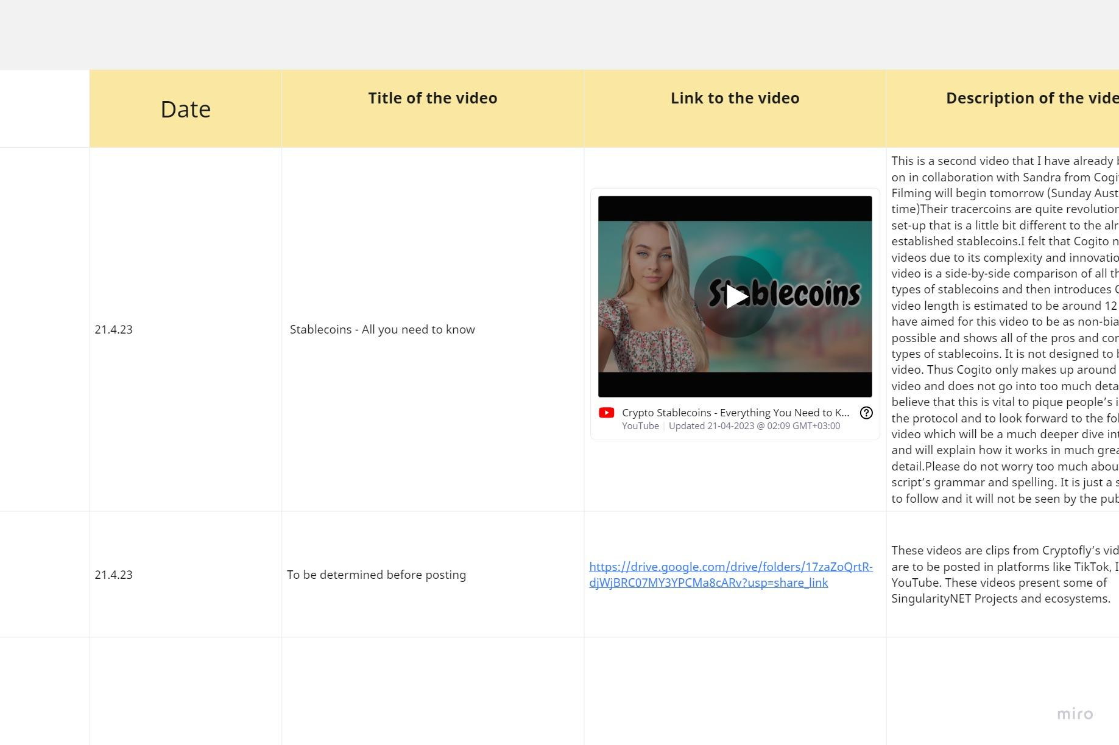
Proposals Accepted

Slide 6
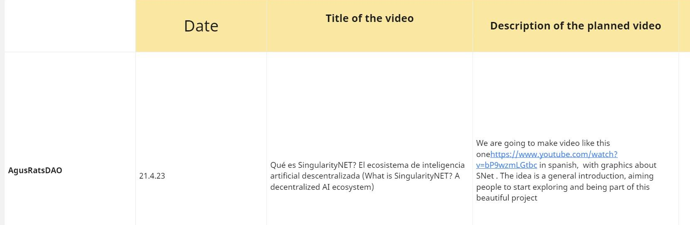
Proposals Accepted

Slide 7
New Proposals
None

Slide 8
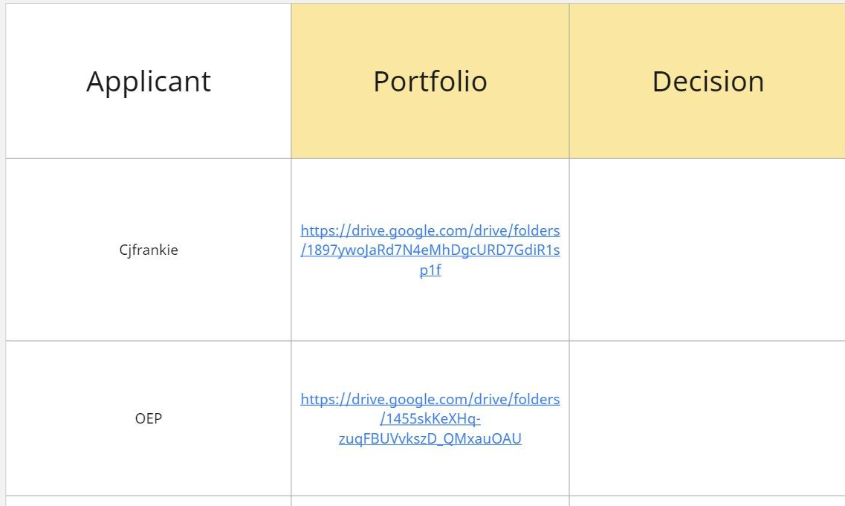
New Workgroup Applicants

Slide 9
Keep up the good work!

